Slide 1
Agenda
Time | Agenda Item | Speaker
10:00 | Welcome and structure of the day | Angela Davies Helen Hulme
10:15 | Experience of applying for a grant and what is involved | Kevin Munroe (Professor of Audiology) Dawn Dowding (Professor of Clinical Decision Making)
10:45 | Funding for digital transformation and tips for a successful grant | Lauren Tempelman (Research Development Manager)
11:15 11:45 | Activity – Developing plain English summaries (Genetics case study) Feedback and wrap up | Angela Davies Helen Hulme
12:00 | Lunch and networking
13:00 | User-centred Design/Team Science workshop (including persona activity) | Simon Foster Karon Mee Ruth Norris Joe Keaney (Expert by experience) Mike Southworth (Expert by experience)
14:30 | Refreshment break and networking
15:00 | Activity – Developing your work plan and your team (Genetics case study) Feedback and wrap up
16:15 | Feedback on activity and wrap up | Angela Davies Helen Hulme
16:30 | Final remarks | Angela Davies Helen Hulme
16:45 | Close

Slide 2
Professor Ang Davies
Co-designing جِین (Gene) a genetics app to improve genetics understanding with the British Pakistani community

Slide 3
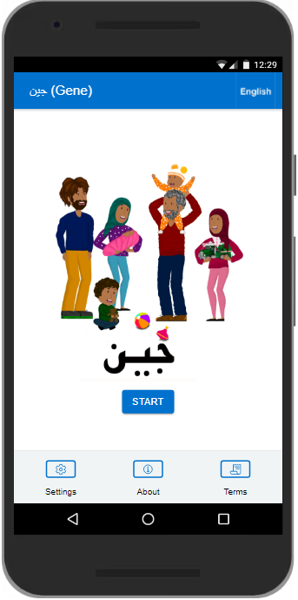
Genetics APP

Slide 4


Background to the app
https://vimeo.com/niftyfoxcreative/review/751552554/ca0ec8f52c
Gene has been co-created with the British Pakistani community in Blackburn with Darwen
Cousin marriages are more common thus there is increased risk of recessive genetic conditions in this community
Attendance at genetic clinics is poor
Support through genetic counselling can help inform marriage and prenatal decision making
Currently there is a paucity of culturally appropriate information available related to genetics, genetic services and close cousin marriages
Our aim: to increase understanding of genetics in the community

Slide 5
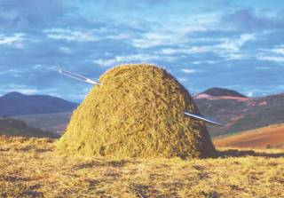



Clinical Scientist:
Bioinformatician
Genome
Technologist
Clinical Scientist:
Geneticist
Genetic
Counsellor
Treatment?
Patients
Clinician

Slide 6
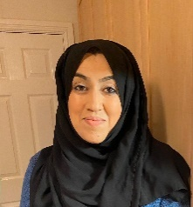
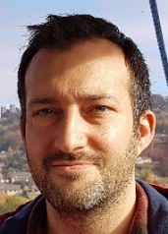
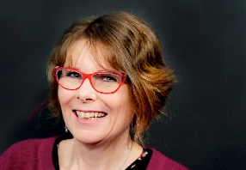
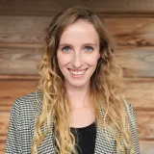
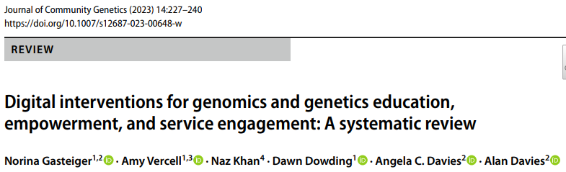
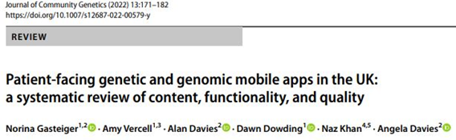
Creating a Genetics App
Interviews with 7 community members
Review of genetic Apps
Review of the literature
Naz Khan
Dr Alan Davies
App Design Requirements
Prof Dawn Dowding
Norina Gasteiger
Amy Vercell
Uzmah Husain
Mustafa Ali
Martin Eden

Slide 7
Approach to Co-Design
Requirements capture
Animation Storyboards 1
Animation Storyboards 2
Prototype
Dissemination
What did we miss?
Involvement in design of the study:
Involvement in consent and patient information sheets (alternate models?)
Paper prototyping
Feedback on scripts for clinical videos (authenticity)

Slide 8
Plain English summary

Slide 9
Application for funding
Aim
To further develop and evaluate an app designed to present culturally sensitive and accessible genetic information for the British Pakistani community to improve genetic literacy and facilitate equitable access to genetic services.
Objectives:
To work in collaboration with members of the British Pakistani community as equal researchers in the project, developing research methods that are culturally appropriate and preferred by the community.
To determine the acceptability of the content and usability of the app جِین (Gene) from the perspective of British Pakistani community members.
To conduct a pilot feasibility study of the implementation of the app into genetic services in England, to inform a future evaluation.

Slide 10
Plain English Summary
Why do we need this?

Slide 11
Plain English Summary – why?
Typically 300-750 words in length
So public understands the value of the research it is funding (often published publicly)
Non-specialist reviewers, funders, policy makers and the media can understand the research
Need for clarity and accessibility
Avoid jargon, use active language & keep sentences short

Slide 12
Over to you - In plain English how would you describe…….
The aim and objectives?
The benefit to patients/carers?
Why we need this research and what’s the scale of the problem?
Key concepts – and which ones would you need to describe?
Involvement of patients/public?

Slide 13
When can you look for help?
NB 15% of UK adults have a literacy level at or below that to be expected of 11 year olds
Use a readability checker – looking for a Flesh Kincaid score of >60 to be readable to general public
Ask someone with no background or a non-medical/scientific background to read it
Involve patients and carers in writing it
Tools: https://www.nihr.ac.uk/documents/plain-english-summaries/27363
https://hemingwayapp.com/

Slide 14
Developing your work plan

Slide 15
Application for funding
Aim
To further develop and evaluate an app designed to present culturally sensitive and accessible genetic information for the British Pakistani community to improve genetic literacy and facilitate equitable access to genetic services.
Objectives:
To work in collaboration with members of the British Pakistani community as equal researchers in the project, developing research methods that are culturally appropriate and preferred by the community.
To determine the acceptability of the content and usability of the app جِین (Gene) from the perspective of British Pakistani community members.
To conduct a pilot feasibility study to trial the implementation of the app to inform a larger-scale trial

Slide 16
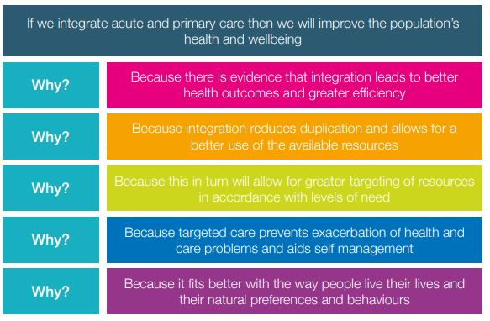
Think you have a solution – so what?
With a defined problem you are likely to develop a hypothesis of how your solution will address this problem.
Eg A hypothesis: “If we integrate acute & primary care then will improve the population’s health and well being”
You can test this with the 5 Why’s approach:

Slide 17
Using Logic Models
A logic model is a graphic which represents the theory of how an intervention produces its outcomes. It represents, in a simplified way, a hypothesis or ‘theory of change’ about how an intervention works.
Designing a programme/project needs to answer a multitude of questions and specifically a funder will want to see the answers:
What is the problem and why should we intervene?
What outcomes are we ultimately likely to achieve?
Given this what changes do we need to see?
What activities do we think will achieve these outcomes and why will they?
What resources are needed?
How will we measure progress?
Are there any assumptions?

Slide 18
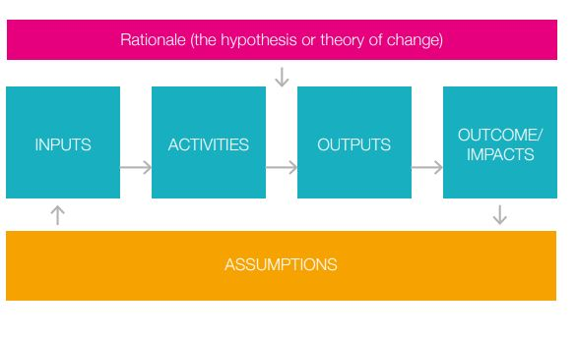
Using Logic Models
They draw out the “If, then” filter
Eg: “if we deploy our app, it will improve understanding of genetics in the Pakistani community”

Slide 19
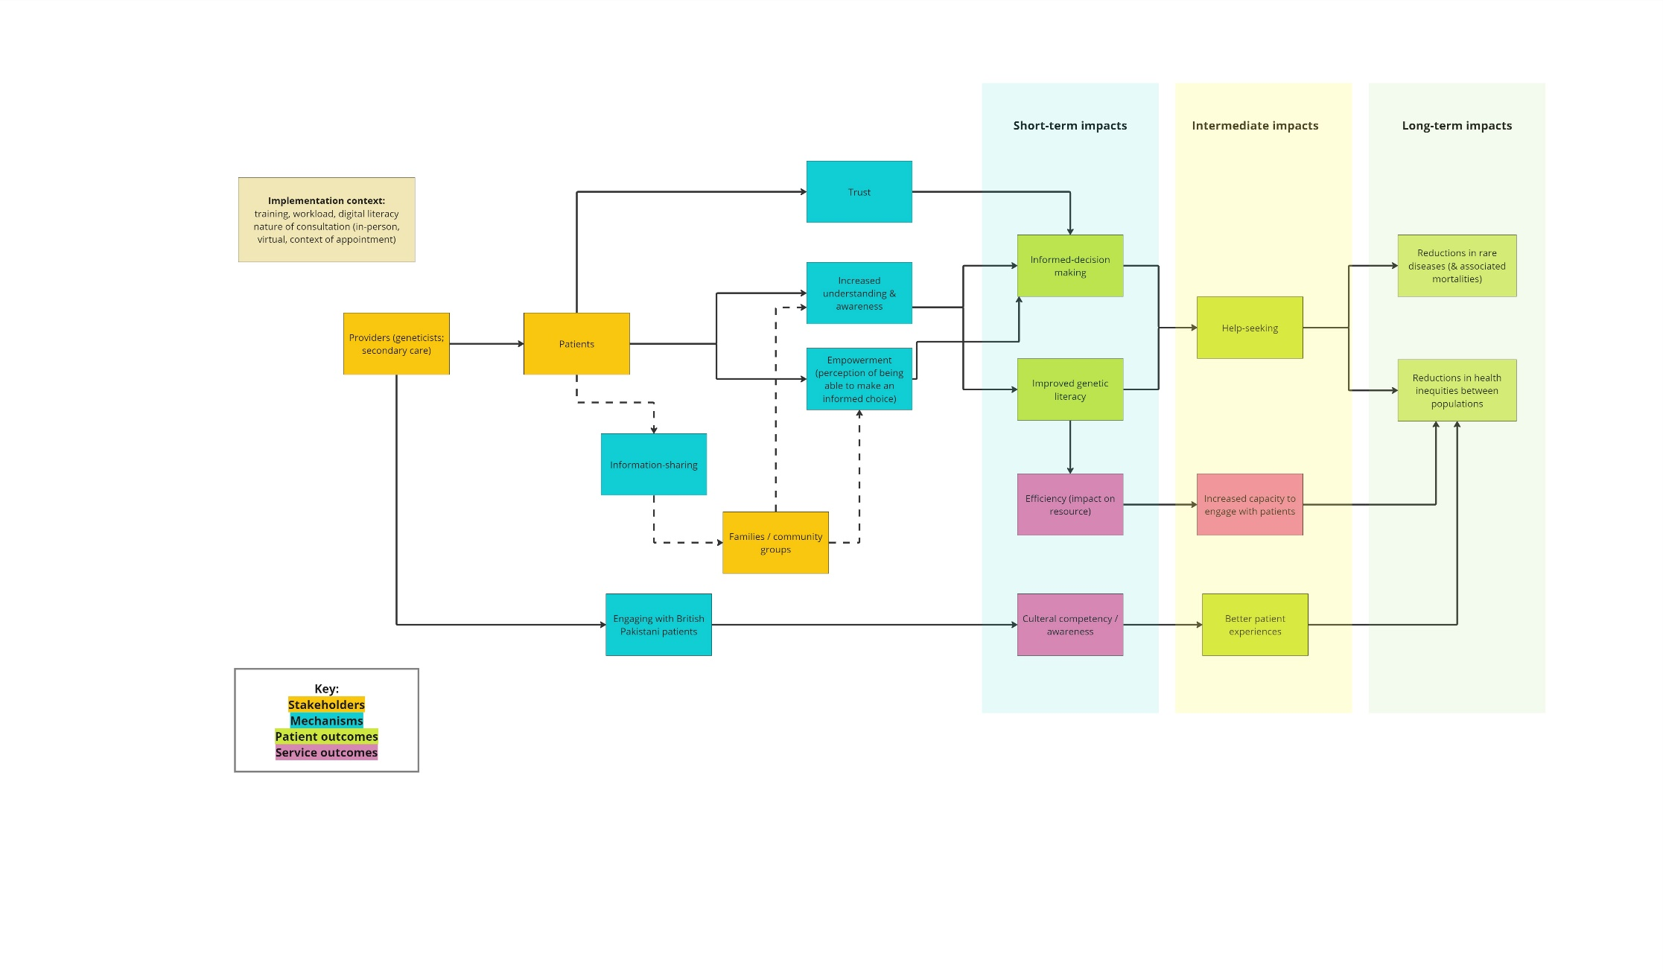
Developing a logic model
Short-term outcomes
Medium-term outcomes
Long-term outcomes

Slide 20
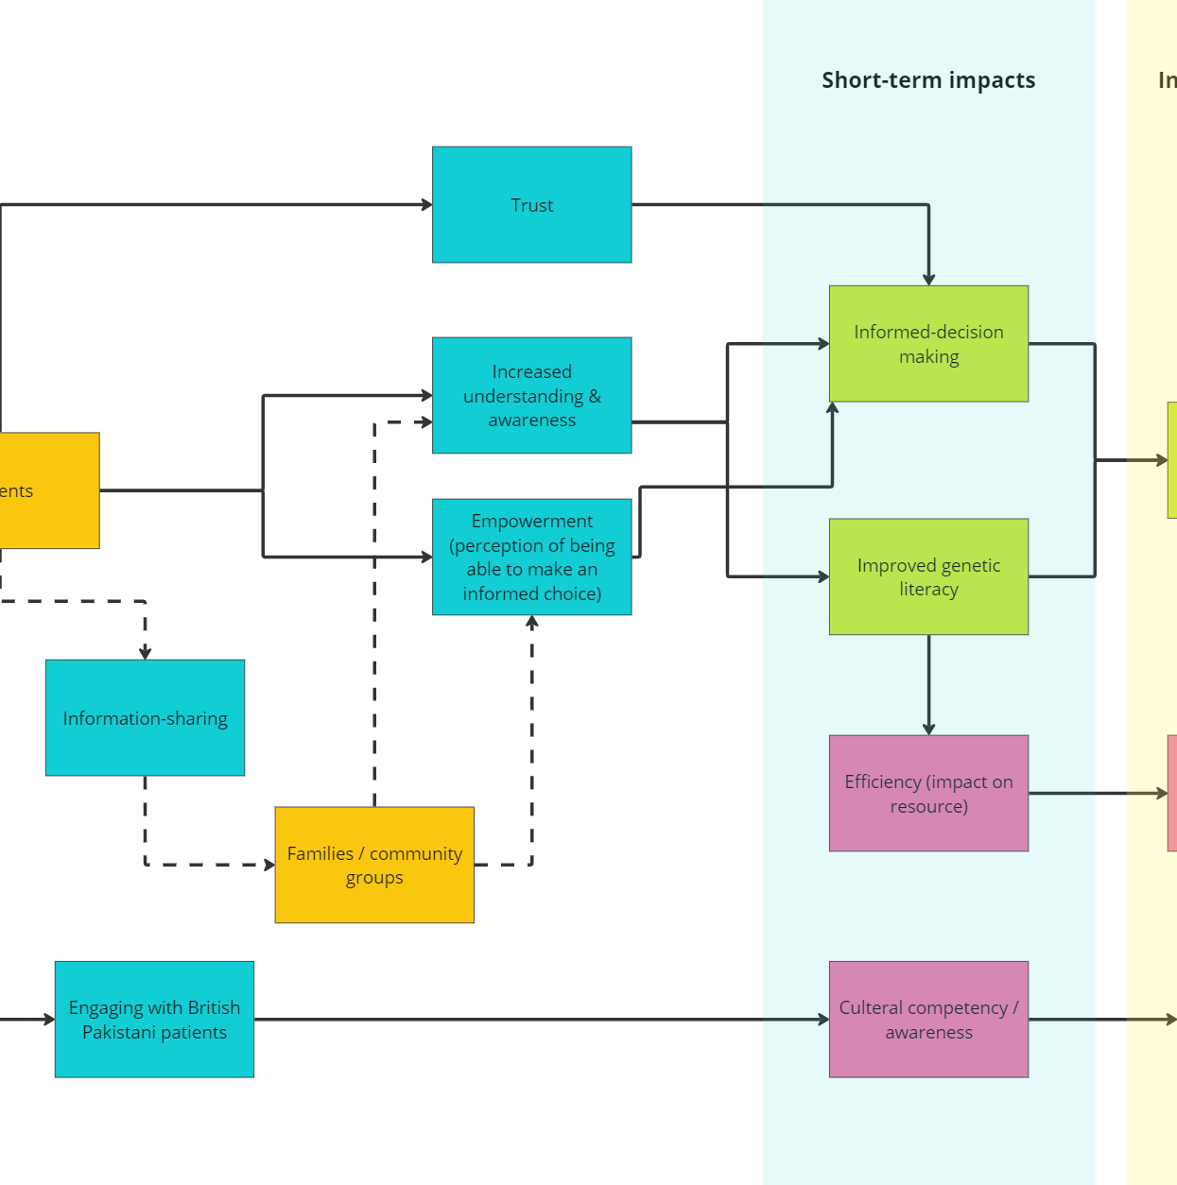
Over to you: Designing a study
Are there any other outcomes you can think of?
How would you measure these and what methodologies might you use?

Slide 21
Over to you: What resources would you need?
What resources would you need?
Consider:
People (their expertise)
Equipment
Training
Collaborations
What assumptions have you made?

Slide 22
Resources
https://www.midlandsandlancashirecsu.nhs.uk/images/Logic_Model_Guide_AGA_2262_ARTWORK_FINAL_07.09.16_1.pdf
https://www.gov.uk/guidance/evaluation-in-health-and-wellbeing-creating-a-logic-model
Moore et al., Process evaluation of complex interventions: Medical Research Council guidance. BMJ. 2015 Mar 19;350:h1258. doi: 10.1136/bmj.h1258. PMID: 25791983; PMCID: PMC4366184.
Contact your Research Support service – free and confidential advice for applications in remit of NIHR

Slide 23


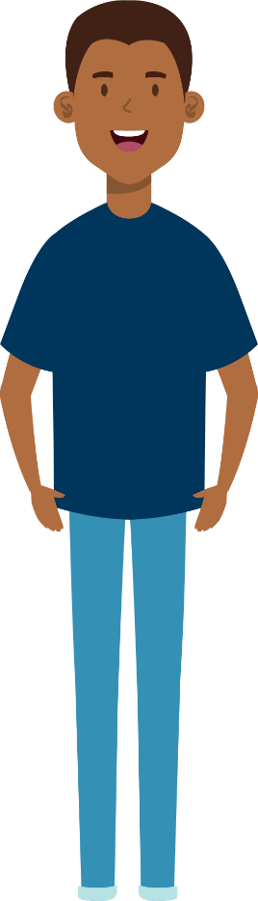
What Next?
Prioritisation of changes from feedback/finalise on IoS devices
Ongoing user feedback from the community (more males)
Observational studies/eye tracking
Feasibility/Evaluation study with MFT
How do we implement this into service and what's the impact?
Ongoing co-design of research materials with the community
Sustainability

